Slide 1
CSC384:Intro to artificial intelligence
TUT9101 Thursdays 9:10-10AM

Slide 2
CSC384 Tutorial 7: Bayesian Networks
Problem 1
Problem 2
Problem 3
Problem 4
Discuss solutions
Questions?

Slide 3
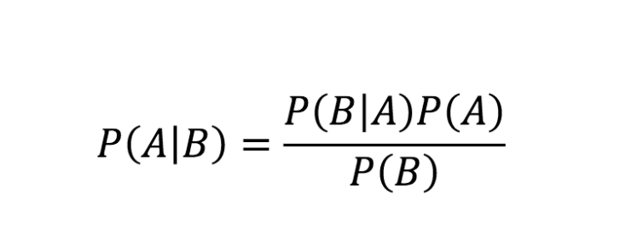
Reminder: Baye’s Rule

Slide 4
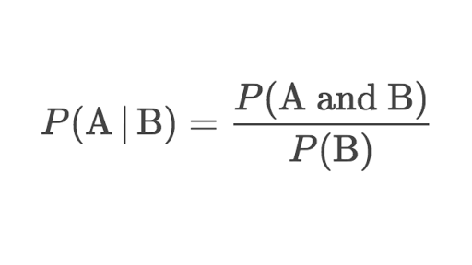
Conditional Probability formula

Slide 5
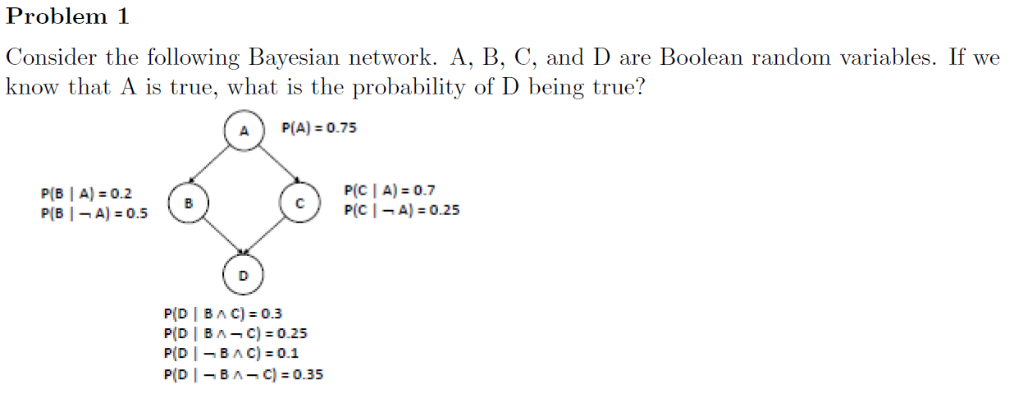
P(D|A)=P(A,D)/P(A)
=(P(A,B,C,D)+P(A,B,notC,D)+P(A,notB,C,D)+P(A,notB, notC, D)/P(A)
=P(B|A)P(C|A)P(D|B,C)+P(B|A)P(notC|A)P(D|B,notC)+ P(notB|A)P(C|A)P(D|notB,C)+P(notB|A)P(notC|A)P(D|notB,notC)
=.2*.7*0.3 + .2*.3*.25 + .8*.7*.1 + .8*.3*.35
=.197

Slide 6
Solution
P(D|A) = P(A,D)/P(A)
= (P(A,B,C,D) + P(A,B;notC,D) + P(A, notB,C,D) + P(A, notB, notC,D))/P(A)
= P(B|A)P(C|A)P(D|B,C) + P(B|A)P(notC|A)P(D|B, notC) + P(notB|A)P(C|A)P(D|notB,C) + P(notB|A)P(notC|A)P(D|notB, notC)
= 0.197

Slide 7
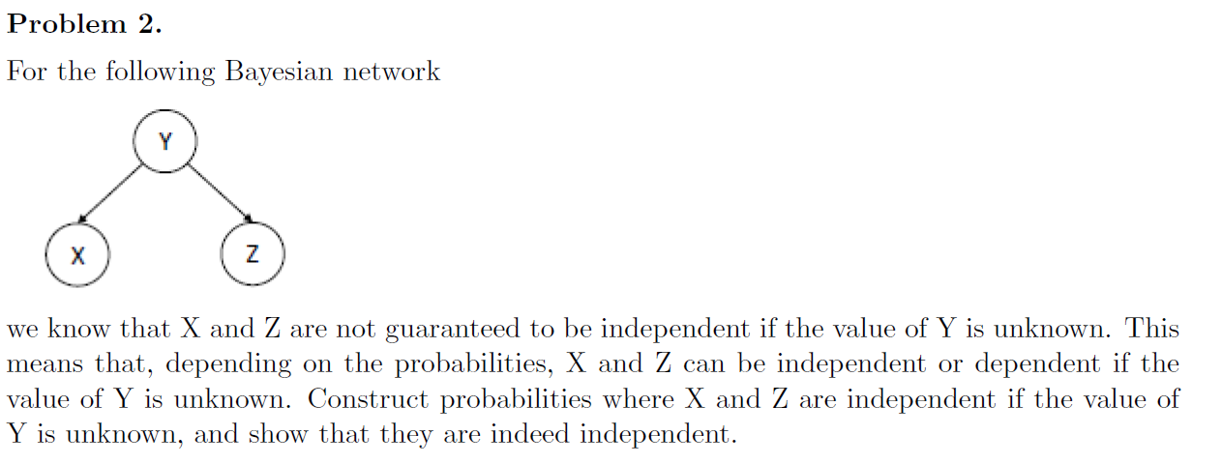
P(X)
P(Z)
P(X,Z) = P(X)P(Z) if they are indep
P(X) = P(X|Y)P(Y) +P(X|notY)P(notY)
P(Z) = P(Z|Y)P(Y) +P(Z|notY)P(notY)
P(X,Z)= P(X,Z,Y)+P(X,Z,notY)
P(X,Z)= P(X|Y)P(Z|Y)P(Y) + P(X|notY)P(Z|notY)P(notY) = 0.25
y=.5 =not y(1-P(y))
z=x=.5
p(z)*p(x) = 0.25

Slide 8
P(X)=P(X|Y)P(Y)+P(X|notY)P(notY)= 0.5
P(Z)=P(Z|Y)P(Y)+P(Z|notY)P(notY)= 0.5
Hint: Independence and sum of probabilities
P(X,Z) = P(X,Z|Y)P(Y)+P(X,Z|notY)P(notY)
P(X)P(Z) = .25 = P(X,Z)

Slide 9
Solution
P(X) = P(Y )P(X|Y ) + P(notY )P(X|notY ) = 0.5
P(Z) = P(Y )P(Z|Y ) + P(notY )P(Z|notY ) = 0.5
P(X,Z) = P(X,Y,Z) + P(X,notY,Z)
= P(Y )P(X|Y )P(Z|Y ) + P(notY )P(X|notY )P(Z|notY)
= 0.25
Therefore, P(X)P(Z) = P(X,Z).

Slide 10
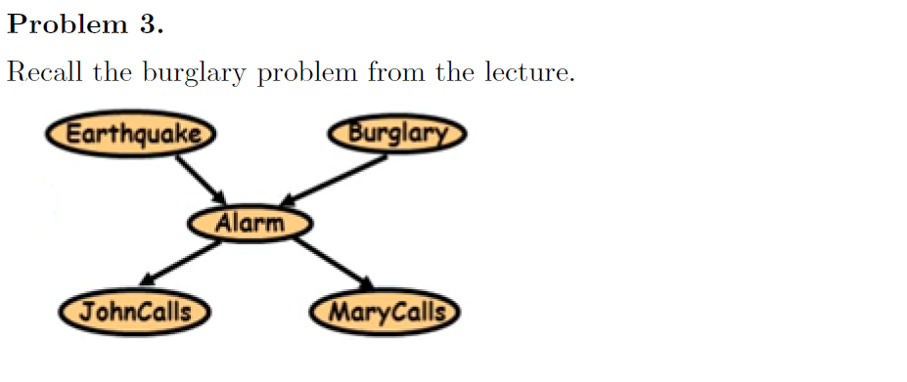
P(J) = P(J|A)P(A)P(J|notA)P(notA)
P(A) = P(A|E)P(E)+P(A|notE)P(notE)+P(A|B)P(B)+P(A|notB)P(notB)
P(M) = P(M|A)P(A)P(M|notA)P(notA)
P(J) = P(J|A) (P(A|E)P(E)+P(A|notE)P(notE)+P(A|B)P(B)+P(A|notB)P(notB))
P(J|notA)(P(notA|E)P(E)+P(notA|notE)P(notE)+P(notA|B)P(B)+P(notA|notB)P(notB))

Slide 11
P(J) = sum(through all nodes) P(E,B,A,M,J)
=P(J|A)P(A)+P(M|A)P(A)+P(A|E)P(E)P(A|B)P(B)
P(M|A) has no effect on P(J|A), P(A) is conditional on E and B not A
So P(J) conditional on A,B,E but not M

Slide 12
Solution

Slide 13
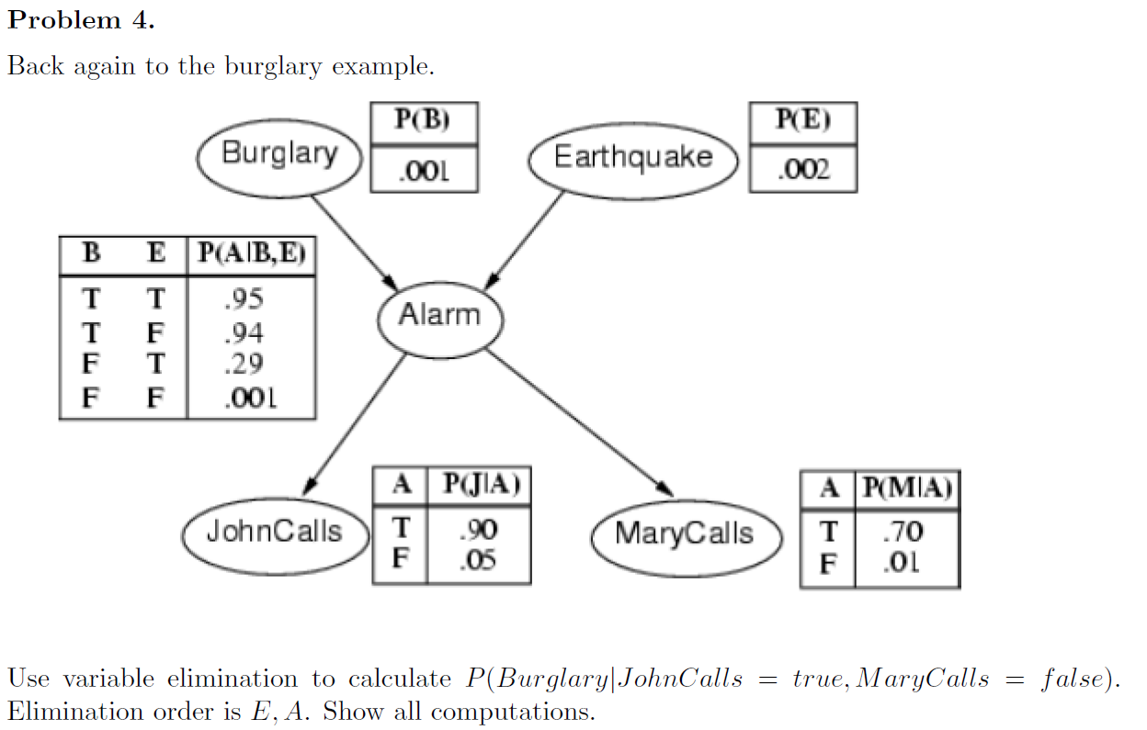

Slide 15
Any questions?

